Slide 1
Inheritance and Polymorphism
Andrew Davison
Noppadon Kamolvilassatian
Department of Computer Engineering
Prince of Songkla University

Slide 2
Contents
1. Key OOP Features
2. Inheritance Concepts
3. Inheritance Examples
4. Implementing Inheritance in C++
5. Polymorphism
6. Inclusion (Dynamic Binding)
7. Virtual Function Examples
8. C++ Pros and Cons

Slide 3
1. Key OOP Features
ADTs (done in the last section)
Inheritance
Polymorphism

Slide 4
2. Inheritance Concepts
Derive a new class (subclass) from an existing class (base class or superclass).
Inheritance creates a hierarchy of related classes (types) which share code and interface.

Slide 5
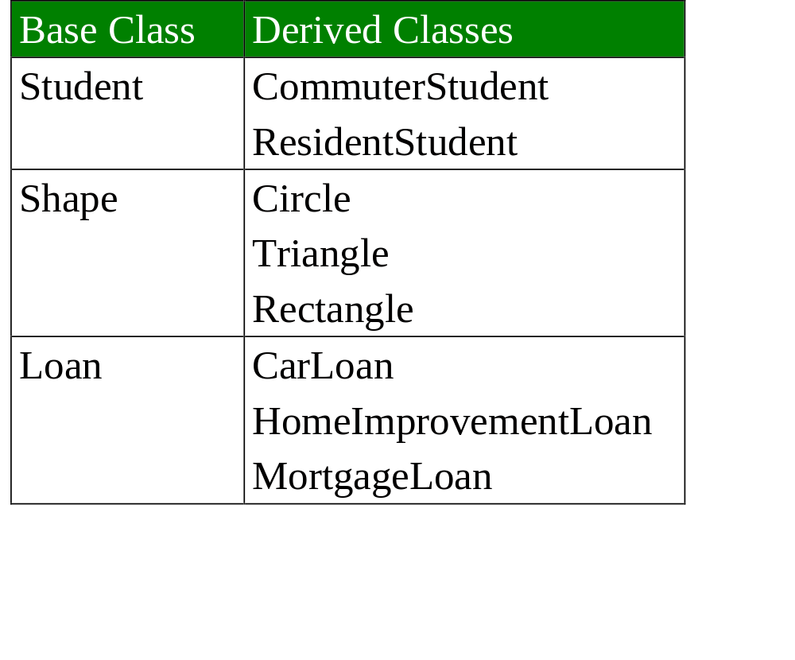
3. Inheritance Examples

Slide 6
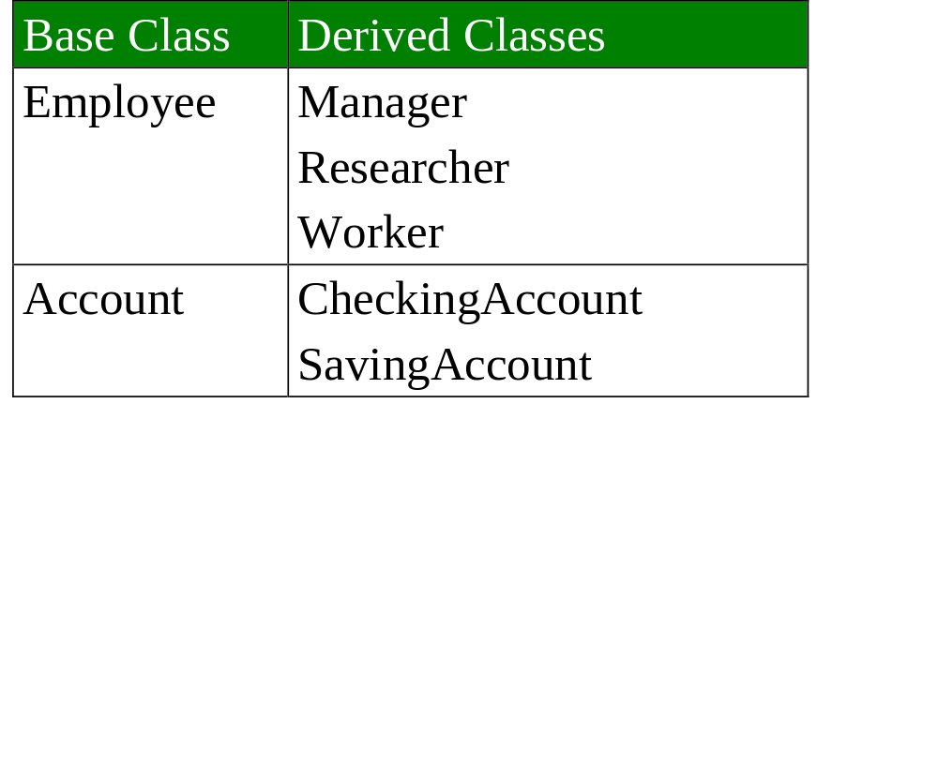
More Examples

Slide 7
University community members
CommunityMember
Employee
Student
Faculty
Staff
Administrator
Teacher

Slide 8
Shape class hierarchy
Shape
TwoDimensionalShape
ThreeDimensionalShape
Circle
Square
Triangle
Sphere
Cube
Tetrahedron

Slide 9
Credit cards
logo
card
owner’s name
inherits
from (isa)
visa
card
master
card
american
express
hologram
pin
category

Slide 10
4. Implementing Inheritance in C++
Develop a base class called student
Use it to define a derived class called grad_student

Slide 11
The Student Class Hierarchy
student
student_id,
year, name
print()
year_group()
inherits (isa)
grad_student
dept,
thesis
print()

Slide 12
Student Class
class student {
public:
student(char* nm, int id, int y);
void print();
int year_group()
{ return year; }
private:
int student_id;
int year;
char name[30];
};

Slide 13
Member functions
student::student(char* nm, int id, int y)
{
student_id = id;
year = y;
strcpy(name, nm);
}
void student::print()
{
cout << "\n" << name << ", "
<< student_id << ", "
<< year << endl;
}

Slide 14
Graduate Student Class
class grad_student: public student {
public:
grad_student(char* nm, int id,
int y, char* d, char* th);
void print();
private:
char dept[10];
char thesis[80];
};

Slide 15
Member functions
grad_student::grad_student(char* nm,
int id, int y, char* d, char* th)
:student(nm, id, y)
{
strcpy(dept, d);
strcpy(thesis, th);
}
void grad_student::print()
{
student::print();
cout << dept << ", " << thesis << endl;
}

Slide 16
Use
int main()
{
student s1("Jane Doe", 100, 1);
grad_student gs1("John Smith", 200, 4,
"Pharmacy", "Retail Thesis");
cout << "Student classes example:\n";
cout << "\n Student s1:";
s1.print();
cout << “Year “ << s1.year_group()
<< endl;
:
continued

Slide 17
cout << "\n Grad student gs1:";
gs1.print();
cout << “Year “ << gs1.year_group()
<< endl;
:

Slide 18
Using Pointers
student *ps;
grad_student *pgs;
ps = &s1;
cout << "\n ps, pointing to s1:";
ps->print();
ps = &gs1;
cout << "\n ps, pointing to gs1:";
ps->print();
pgs = &gs1;
cout << "\n pgs, pointing to gs1:";
pgs->print();
return 0;
}

Slide 19
Output
$ g++ -Wall -o gstudent gstudent.cc
$ gstudent
Student classes example:
Student s1:
Jane Doe, 100, 1
Year 1
Grad student gs1:
John Smith, 200, 4
Pharmacy, Retail Thesis
Year 4
:
continued

Slide 20
student print() used.
ps, pointing to s1:
Jane Doe, 100, 1
ps, pointing to gs1:
John Smith, 200, 4
pgs, pointing to gs1:
John Smith, 200, 4
Pharmacy, Retail Thesis
$
grad_student print() used.

Slide 21
Notes
The choice of print() depends on the pointer type, not the object pointed to.
This is a compile time decision
(called static binding).

Slide 22
5. Polymorphism
Webster: "Capable of assuming various forms."
Four main kinds:
1. coercion
  a / b
2. overloading
  a + b
continued

Slide 23
3. inclusion (dynamic binding)
  Dynamic binding of a function call to a function.
4. parametric
  The type argument is left unspecified and is later instantiated
  e.g generics, templates

Slide 24
6. Inclusion (dynamic binding)
5.1. Dynamic Binding in OOP
5.2. Virtual Function Example
5.3. Representing Shapes
5.4. Dynamic Binding Reviewed

Slide 25
Dynamic Binding in OOP
Classes
X
print()
X x;
Y y;
Z z;
X *px;
px = & ??;
// can be x,y,or z
px->print(); // ??
inherits (isa)
Y
print()
Z
print()

Slide 26
Two Types of Binding
Static Binding (the default in C++)
  px->print() uses X’s print
  this is known at compile time
Dynamic Binding
  px->print() uses the print() in the object pointed at
  this is only known at run time
  coded in C++ with virtual functions

Slide 27
Why “only known at run time”?
Assume dynamic binding is being used:
X x;
Y y;
Z z;
X *px;
:
cin >> val;
if (val == 1)
px = &x;
else
px = &y;
px->print(); // which print() is used?

Slide 28
7. Virtual Function Examples
class B {
public:
int i;
virtual void print()
{ cout << "i value is " << i
<< " inside object of type B\n\n"; }
};
class D: public B {
public:
void print()
{ cout << "i value is " << i
<< " inside object of type D\n\n"; }
};

Slide 29
Use
int main()
{
B b;
B *pb;
D d;
// initilise i values in objects
b.i = 3;
d.i = 5;
:

Slide 30
pb = &b;
cout << "pb now points to b\n";
cout << "Calling pb->print()\n";
pb->print(); // uses B::print()
pb = &d;
cout << "pb now points to d\n";
cout << "Calling pb->print()\n";
pb->print(); // uses D::print()
return 0;
}

Slide 31
Output
$ g++ -Wall -o virtual virtual.cc
$ virtual
pb now points to b
Calling pb->print()
i value is 3 inside object of type B
pb now points to d
Calling pb->print()
i value is 5 inside object of type D
$

Slide 32
7.1 Representing Shapes
shape
inherits (isa)
rectangle
• • • •
triangle
circle
square

Slide 33
C++ Shape Classes
class shape {
public:
virtual double area() = 0;
};
class rectangle: public shape {
public:
double area() const
{return (height*width);}
:
private:
double height, width;
};

Slide 34
class circle: public shape {
public:
double area() const
{return (PI*radius*radius);}
:
private:
double radius;
};
// etc

Slide 35
Use:
shape* p[N];
circle c1,...;
rectangle r1,...;
:
// fill in p with pointers to
// circles, squares, etc
p[0] = &c1; p[1] = &r1; ...
:
:
// calculate total area
for (i = 0; i < N; ++i)
tot_area = tot_area + p[i]->area();

Slide 36
Coding shape in C
enum shapekinds {CIRCLE, RECT, ...};
struct shape {
enum shapekinds s_val;
double centre, radius, height, ...;
:
/* data for all shapes must
go here */
};
continued

Slide 37
double area(shape *s)
{
switch (s->s_val) {
case CIRCLE:
return (PI*s->radius*s->radius);
case RECT:
return (s->height*s->width);
:
/* area code for all shapes must
go here */
}
add a new kind of shape?

Slide 38
Dynamic Binding Reviewed
Advantages:
  Extensions of the inheritance hierarchy leaves the client’s code unaltered.
  Code is localised – each class is responsible for the meaning of its functions (e.g. print()).
Disadvantage:
  (Small) run-time overhead.

Slide 39
8. C++ Pros and Cons
6.1. Reasons for using C++
6.2. Reasons for not using C++

Slide 40

8.1 Reasons for using C++
bandwagon effect
C++ is a superset of C
  familiarity
  installed base can be kept
  can ‘pretend’ to code in C++
efficient implementation
continued

Slide 41
low-level and high-level features
portable
a better C
no need for fancy OOP resources

Slide 42
8.2 Reasons for not using C++
a hybrid
size
confusing syntax and semantics
programmers must decide between efficiency and elegance
no automatic garbage collection

